Slide 1
EED206 : Project Task 7
Project Members :
1.Aavesh Kumar
2. Manan Gupta
3. Ajay Gaur
4. Devesh Tomar
https://www.edaplayground.com/x/NJLv

Slide 2
Aim
An ALU (Arithmetic Logic unit) can perform the following Arithmetic and Logic operations on two 8-bit inputs A and B and a Carry/Borrow Flag CI set in earlier operations to generate an 8-bit output Y and a Carry/Borrow flag CO. The operation will depend on the value of a 2-bit Op Code such that:
Op Code = 00 : Y = A + B + CI
Op Code = 01 : Y = A – B - CI
Op Code = 10 : Y = A + B (Bit-wise Logic) (OR Gate)
Op Code = 11 : Y = A.B (Bit-wise Logic) (AND Gate)

Slide 3
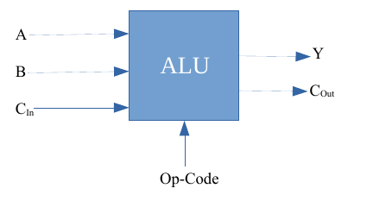
Block Diagram

Slide 4
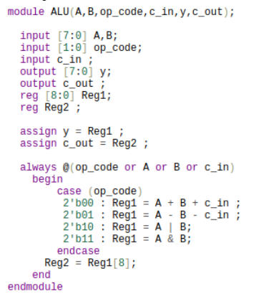
Code for Design

Slide 5
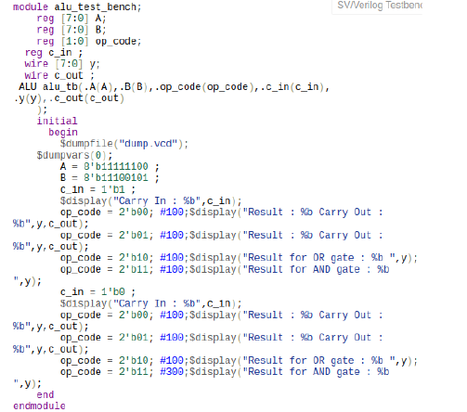
Code for Test Bench

Slide 6
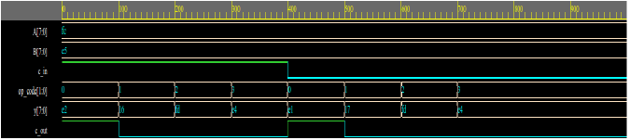
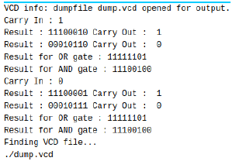
Screenshot Of Timing Diagrams and Output

